Slide 1

K-Nearest Neighbors
Notes:
‹#›

Slide 2
Objectives
What is k-nearest neighbors?
How does k-nearest neighbors work?
When to use k-nearest neighbors?
Overfitting and underfitting scenarios.

Slide 3
How does KNN work?
Procedure:
Load the data
Initialize K to an integer value that represents your number of neighboring samples
Calculate the distance between samples using the Euclidean, Manhattan, or Hamming distance
Sort the computed distances in ascending order
Select the top K rows from the sorted array
Finally, a class is assigned to the sample based on the most frequent class of these three rows

Slide 4
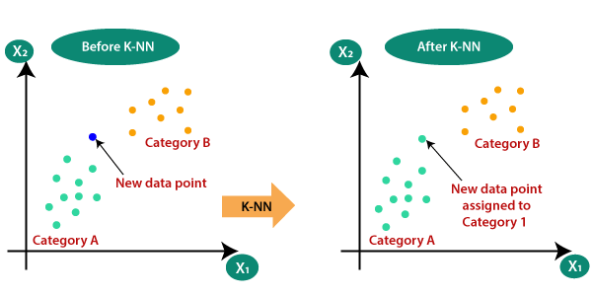
What is K-Nearest Neighbors?
Supervised machine learning algorithm.
Can be used for classification and regression problems.
Assumption: when plotted on a graph, similar data exist in close proximity.
kNN looks at the distance between samples, also known as neighbors, and can distinguish what a sample is based on the proximity.

Slide 5
When to Use KNN?
When given a labeled dataset, kNN can be used as it is a supervised machine learning algorithm that operates on labeled data.
Main advantage of using kNN over other algorithms: kNN can be used for multiclass classification.
If you are attempting to classify data in more than two labels, kNN can be the optimal algorithm to use.

Slide 6
Overfitting and Underfitting Scenarios
If too many neighbors are initialized and used, underfitting may occur which means that the samples are not considered to be important enough.
If too few neighbors are initialized and used, overfitting may occur which means that each sample is too important.

